Slide 1
SOLID Principles of OOD
Chris Gibson
Sameeri Marryboyina

Slide 2
Thank You!

Slide 3
Questions

Slide 4
EPP Motivation

Slide 5
Engineering Philosophy
Beautiful, Maintainable Code
We want to “Care” about our code.
Kaizen
Yesterday we have code that works.
Today we want to improve it.

Slide 6
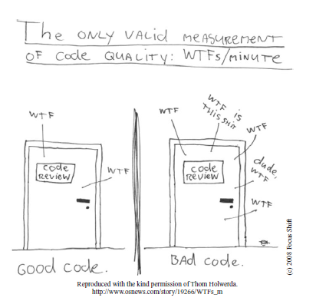
Clean Code

Slide 7
The One CONSTANT in Software development
CHANGE

Slide 8
How does our software respond to CHANGE?

Slide 9
Code Smells
Refactoring – Improving the design of existing code [Martin Fowler]
Clean Code : A handbook of Agile Software Craftsmanship [Bob Martin]
Catalog of smells

Slide 10
Design Smells
Rigidity
Fragility
Viscosity
Immobility
Opacity
Notes:
Rigidity is the tendency for software to be difficult to change, even in simple ways. A design is rigid if
a single change causes a cascade of subsequent changes in dependent modules. The more modules
that must be changed, the more rigid the design.
Fragility is the tendency of a program to break in many places when a single change is made. Often,
the new problems are in areas that have no conceptual relationship with the area that was changed.
Fixing those problems leads to even more problems, and the development team begins to resemble a
dog chasing its tail.
A design is immobile when it contains parts that could be useful in other systems, but the effort and
risk involved with separating those parts from the original system are too great. This is an
unfortunate but very common occurrence.
A viscous project is one in which the design of the software is difficult to preserve. We
want to create systems and project environments that make it easy to preserve and improve the
design.
Opacity is the tendency of a module to be difficult to understand. Code can be written in a clear and
expressive manner, or it can be written in an opaque and convoluted manner. Code that evolves over
time tends to become more and more opaque with age. A constant effort to keep the code clear and
expressive is required in order to keep opacity to a minimum.

Slide 11
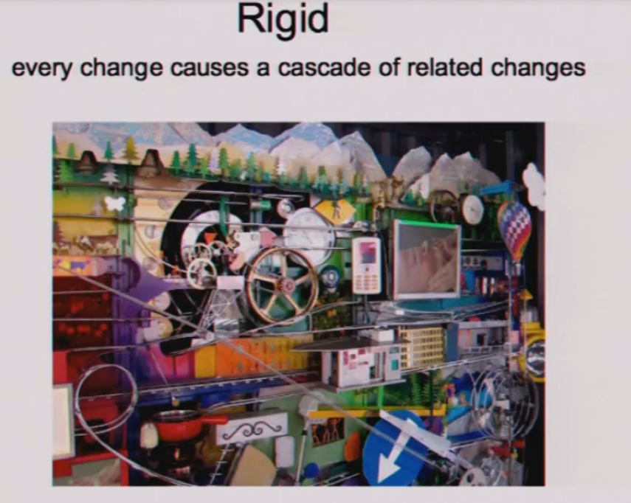

Slide 12
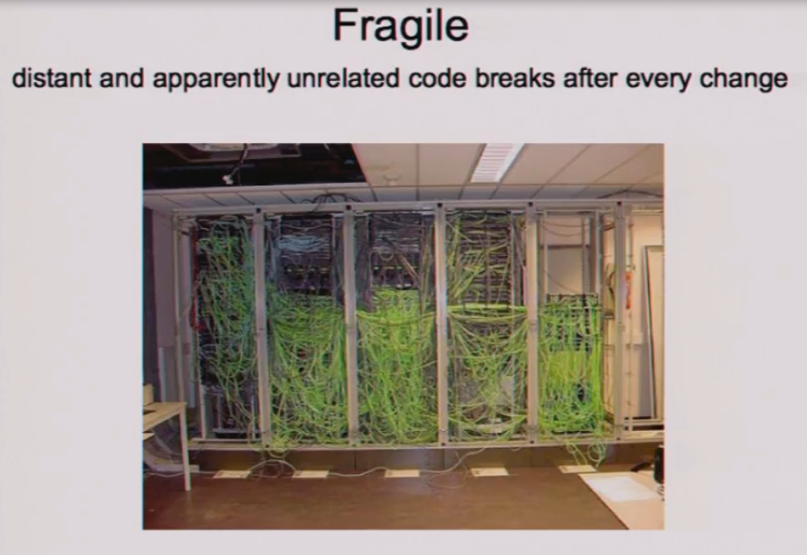

Slide 13
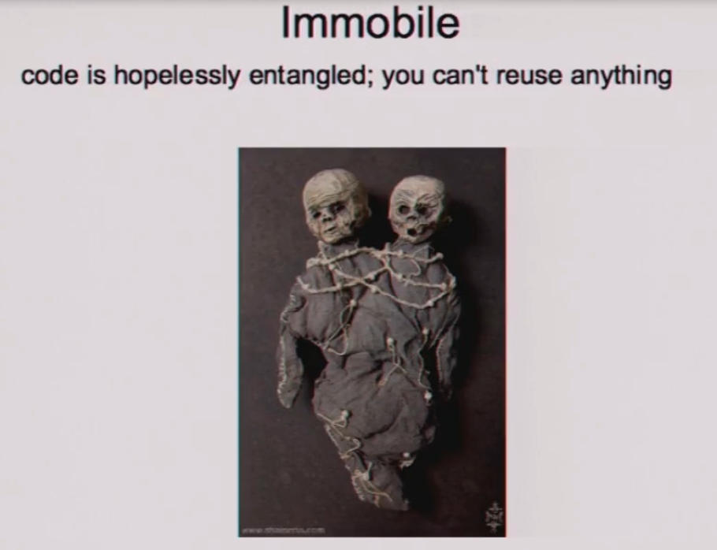

Slide 14
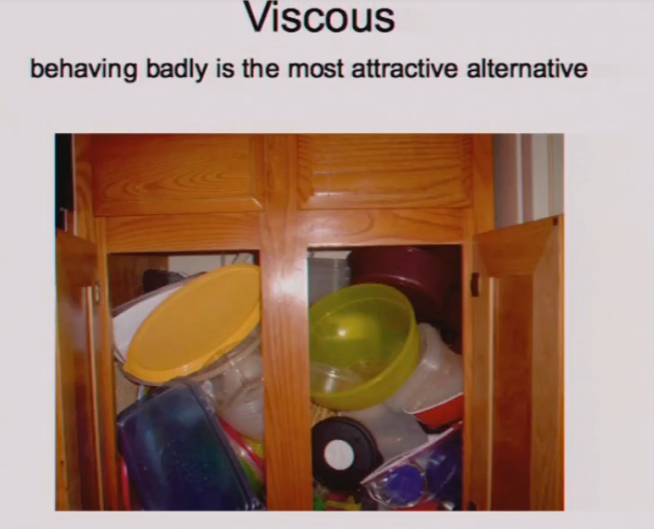

Slide 15
Other OO Developers
Have committed the same mistakes
Have learnt from those mistakes
Have specified some GUIDELINES
We can choose to follow or not!
If we choose to follow, we have to understand the problems and where they apply.
If we encounter the same issues, we can meditate on these guidelines and apply them.

Slide 16
SOLID Design Principles

Slide 17
What are SOLID principles about?
Better question would be : What problems are they trying to solve?
They are trying to solve a specific set of problems, namely

Slide 18
DEPENDENCY MANAGEMENT ISSUES

Slide 19
Talk is cheap, show me the code - Linus Torvalds

Slide 20
SOLID principles of Object Oriented Design
Single Responsibility Principle
Open/Closed Principle
Liskov Substitution Principle
Interface Segregation Principle
Dependency Inversion Principle

Slide 21
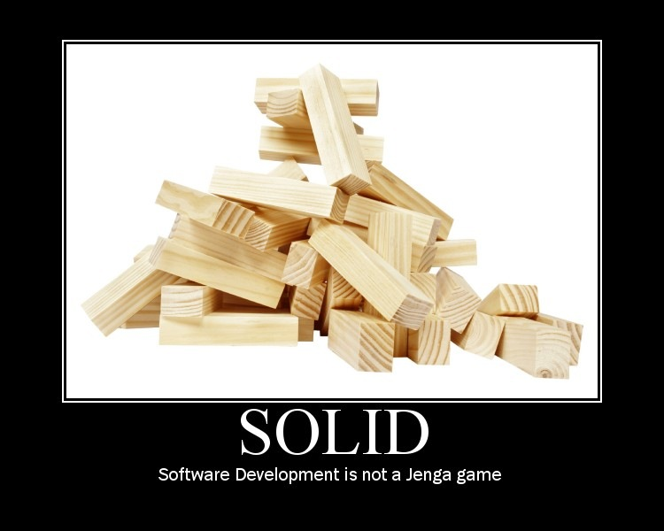

Slide 22
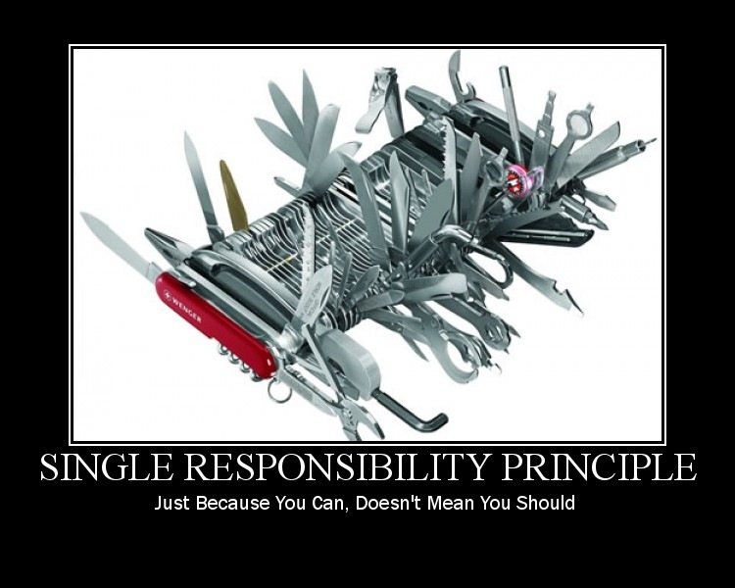

Slide 23
SRP Notes

Slide 24


Slide 25
OCP Notes

Slide 26
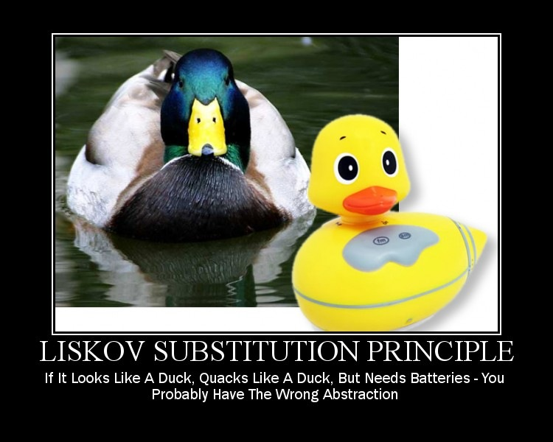

Slide 27
LSP Notes

Slide 28
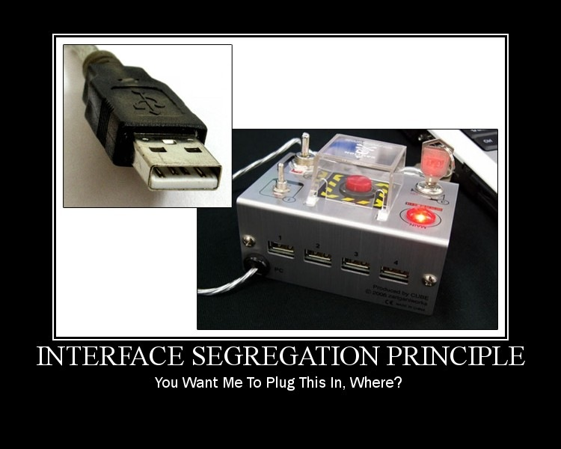

Slide 29
ISP Notes

Slide 30
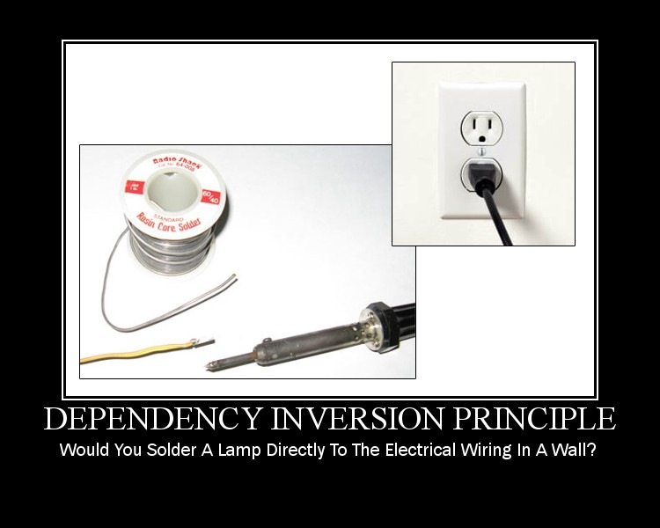

Slide 31
DIP Notes

Slide 32
Platform for applying SOLID Design Principles
TDD (Red, Green, Refactor)

Slide 33
Leave the campsite a little better -Boyscouts

Slide 34
What Next?
Meditate on these principles.
For us, its constant learning.
Design Patterns & Refactoring to Patterns
Architectural Patterns

Slide 35
References

